Slide 1


Supervised ML Classification Capstone Project
Mobile Price Range Prediction
Tanvir Patel
(tanviripatel1998@gmail.com

Slide 2
classification in supervised learning
The Classification algorithm is a Supervised Learning technique that is used to identify the category of new observations on the basis of training data. In Classification, a program learns from the given dataset or observations and then classifies new observation into a number of classes or groups.
difference of classification and regression
The most significant difference between regression vs classification is that while regression helps predict a continuous quantity, classification predicts discrete class labels.

Slide 3

Problem Statement
In the competitive mobile phone market companies want to understand sales data of mobile phones and factors which drive the prices.
The objective is to find out some relation between features of a mobile phone(e.g.:- RAM, Internal Memory, etc.) and its selling price. In this problem, we do not have to predict the actual price but a price range indicating how high the price is.

Slide 4

Points to discuss:
Data description and summary
Data Preprocessing
Getting the dataset
Importing libraries
Importing datasets
Finding Missing Data
Encoding Categorical Data
Exploratory data analysis
Heat map
Machine learning algorithms
Logistic regression
Decision tree
Random forest classifier
SVM
Conclusion

Slide 5
Data description
The data contains information regarding mobile phone features, specifications etc and their price range. The various features and information can be used to predict the price range of a mobile phone.
Battery_power - Total energy a battery can store in one time measured in mAh
Blue - Has bluetooth or not
Clock_speed - speed at which microprocessor executes instructions
Dual_sim - Has dual sim support or not
Fc - Front Camera megapixels
Four_g - Has 4G or not
Int_memory - Internal Memory in Gigabytes
M_dep - Mobile Depth in cm
Mobile_wt - Weight of mobile phone

Slide 6
Data description
N_cores - Number of cores of processor
Pc - Primary Camera megapixels
Px_height - Pixel Resolution Height
Px_width - Pixel Resolution Width
Ram - Random Access Memory in Megabytes
Sc_h - Screen Height of mobile in cm
Sc_w - Screen Width of mobile in cm
Talk_time - longest time that a single battery charge will last when you are
Three_g - Has 3G or not
Touch_screen - Has touch screen or not
Wifi - Has wifi or not
Price_range - This is the target variable with value of 0(low cost), 1(medium cost),
2(high cost) and 3(very high cost).

Slide 7


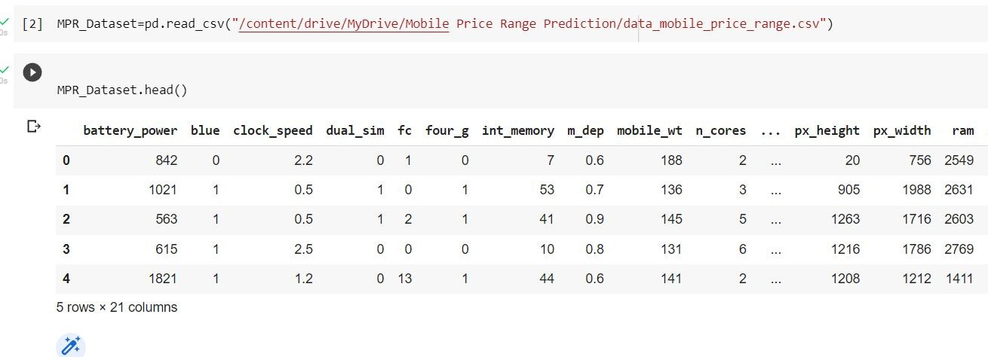
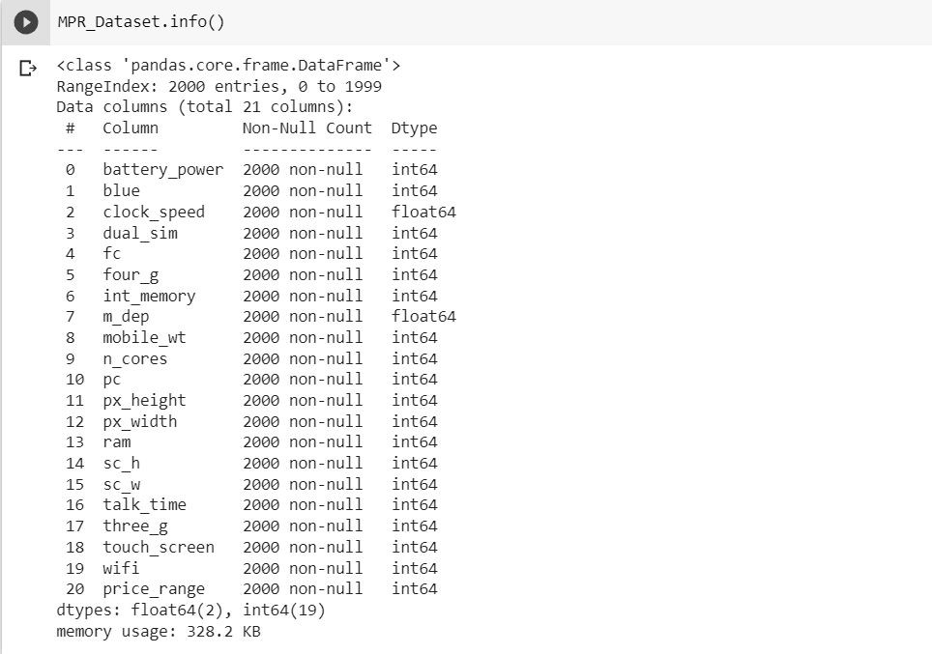
Data Preprocessing
Read and write Mobile Price Range (tabular) data using pandas functions
The info() method prints information about the
Mobile Price Range Data Frame. The information contains the number of columns, column labels, column data types, memory usage, range index, and the number of cells in each column (non-null values).

Slide 8


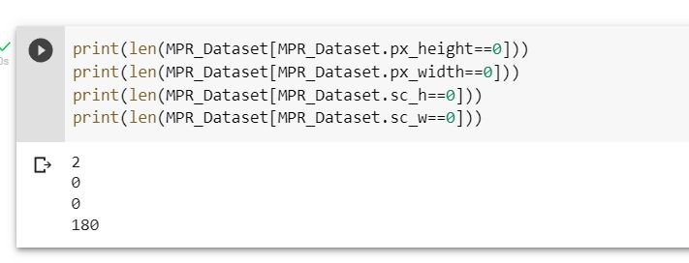
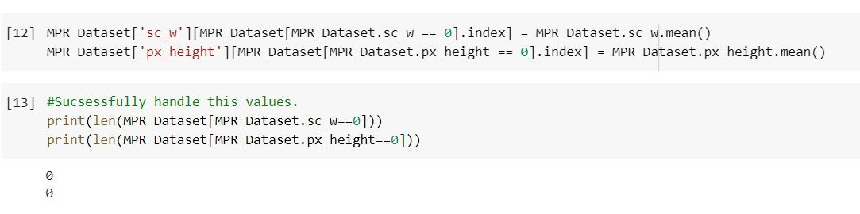
Firstly check the minimum value of pixel width, pixel Height and Screen ,Width Screen Height is cannot be Zero.
I can found the zero value in pixel Height and screen width columns. So handle this value assigning mean .

Slide 9


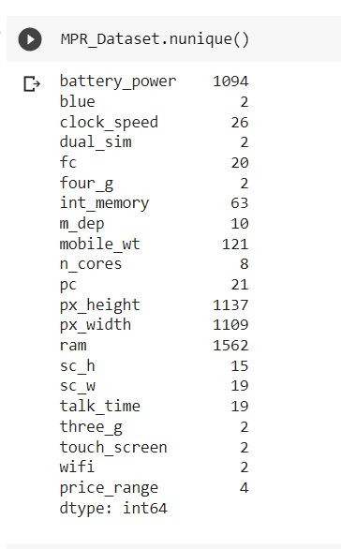
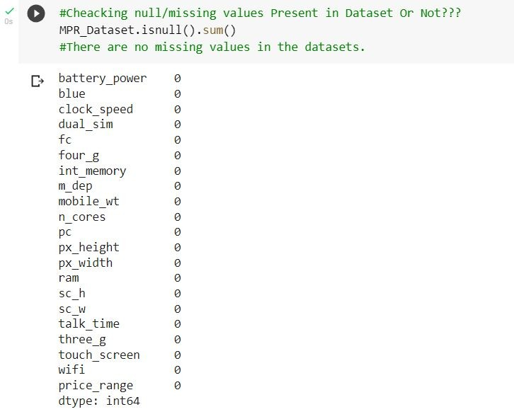
The pandas.unique() function returns the unique values present in a dataset.
We will count total number of NaN data present in Mobile Price Range dataset
and find out the number of NaN or missing values in each columns.

Slide 10
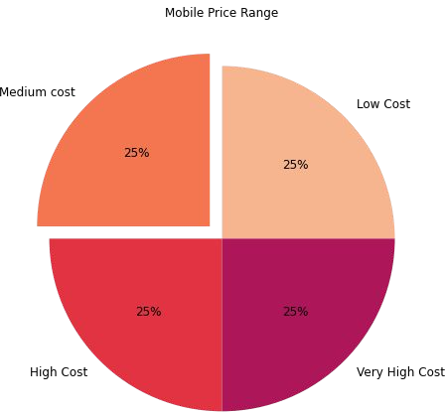
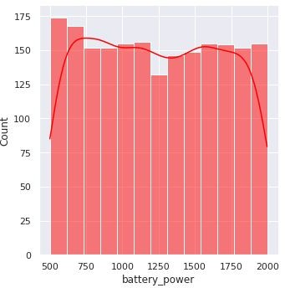
Exploratory data analysis
PRICE
BATTERY
we can see that ,this pie chart there are mobile phones in 4 price ranges. the number of elements is almost similar
This plot shows how the battery mAh is spread. there is a gradual increase as the price range increases

Slide 11
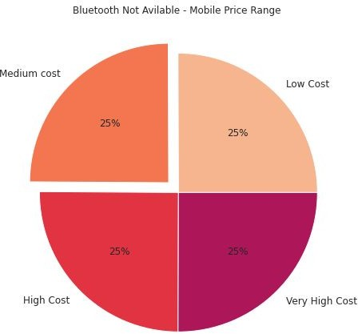
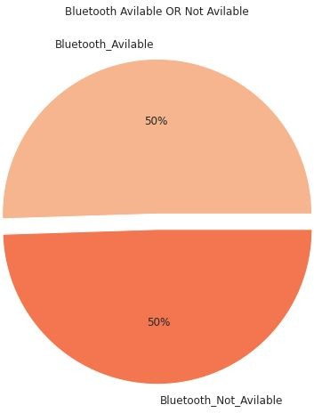

BLUETOOTH
This Bluetooth features distribution is almost similar along all the price ranges variable, it may not be helpful in making predictions
half the devices have Bluetooth, and half don’t

Slide 12
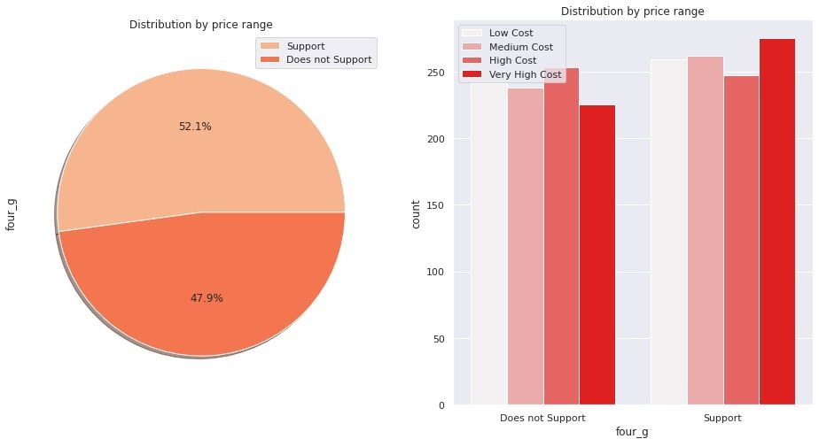
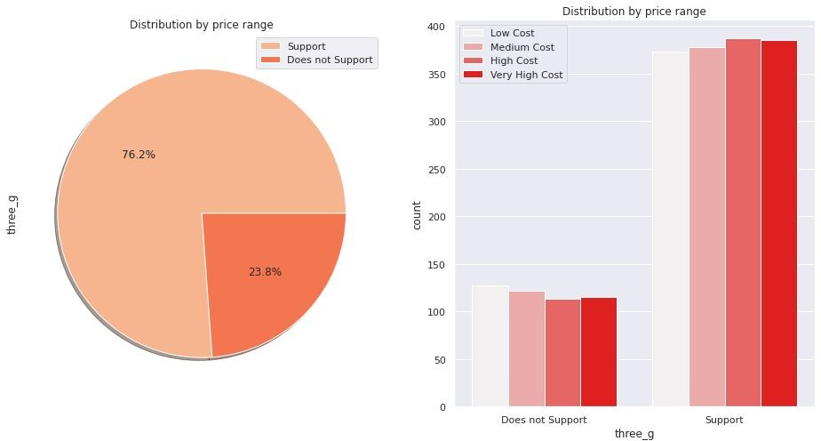
3G AND 4G
50% of the phones support 4_g and 76% of phones support 3_g
Distribution of price range almost similar of supported and unsupported feature in 4G . So that is not used full of prediction.
feature ‘ThreeG' play an important feature in prediction

Slide 13
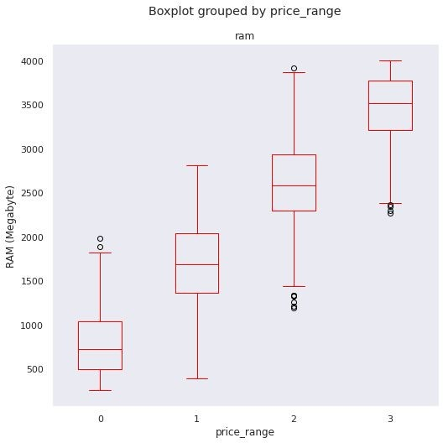
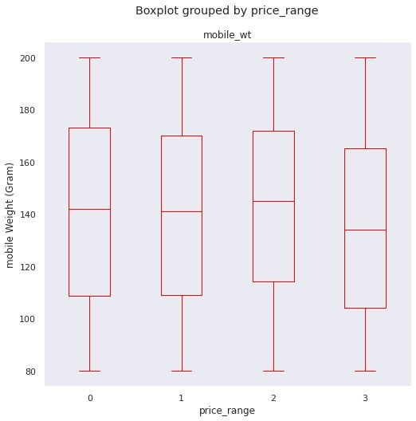
MOBILE WEIGHT
RAM
Ram has continuous increase with price range while moving from Low cost to Very high cost.
we can see that ,this boxplot costly phones are lighter weight

Slide 14
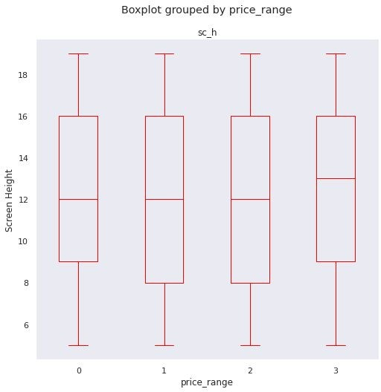
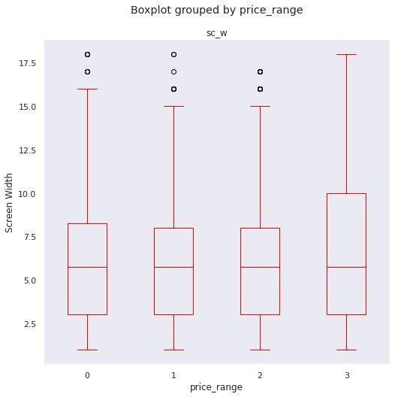
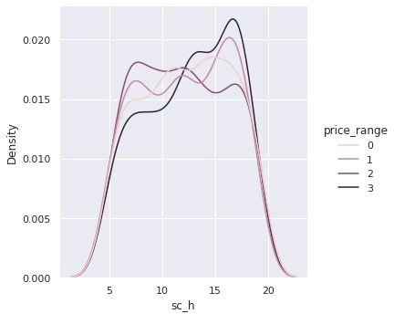
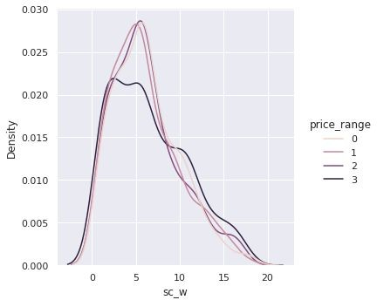
SCREEN HEIGHT
SCREEN WIDTH
There is not a continuous increase in pixel width as we move from Low cost to Very high cost. Mobiles with 'Medium cost' and 'High cost' has almost equal pixel width. so we can say that it would be a driving factor in deciding price range.
Pixel height is almost similar as we move from Low cost to Very high cost. Little variation in pixel height

Slide 15
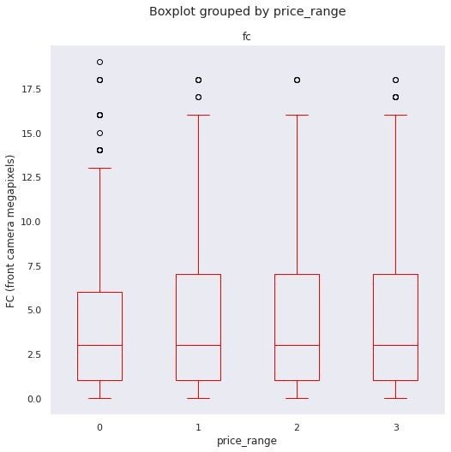
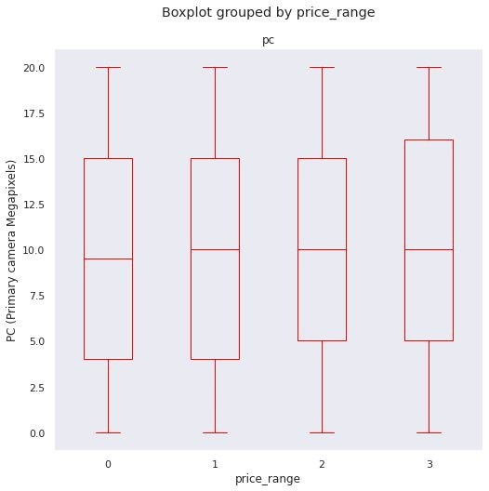
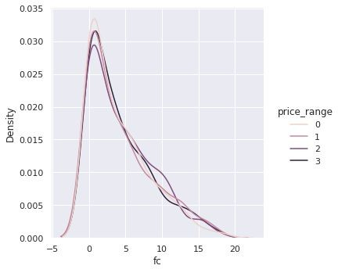
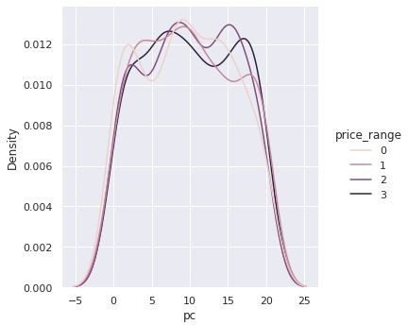
FC (front camera megapixels)
PC (Primary camera Megapixels)
This features distribution is almost similar along all the price ranges variable, it may not be helpful in making predictions
Primary camera megapixels are showing a little variation along the target categories, which is a good sign for prediction.

Slide 16
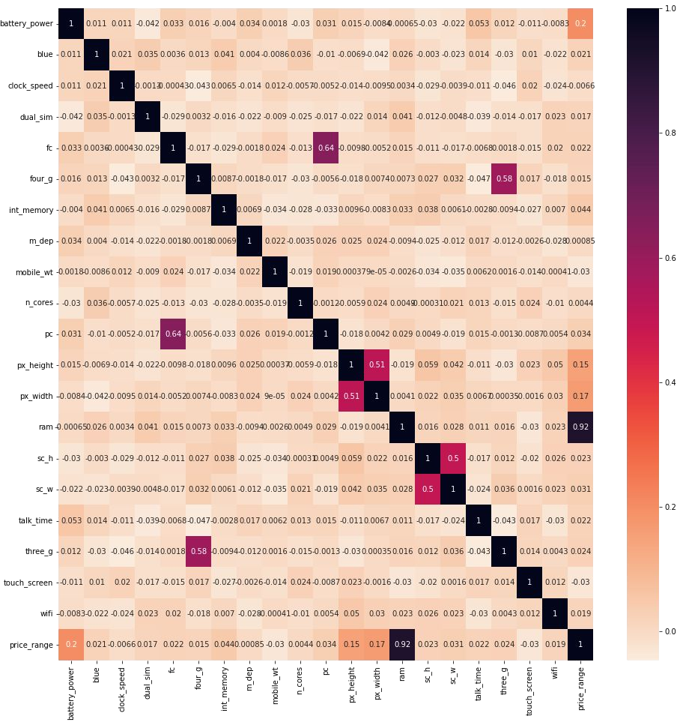
HEAT MAP
RAM and price range shows high correlation which is a good sign, it signifies that RAM will play major deciding factor in estimating the price range.
There is some collinearity in feature pairs ('pc', 'fc') and ('px_width', 'px_height'). Both correlations are justified since there are good chances that if front camera of a phone is good, the back camera would also be good.
Also, if px_height increases, pixel width also increases, that means the overall pixels in the screen. We can replace these two features with one feature. Front Camera megapixels and Primary camera megapixels are different entities despite of showing collinearity. So we'll be keeping them as they are.

Slide 17
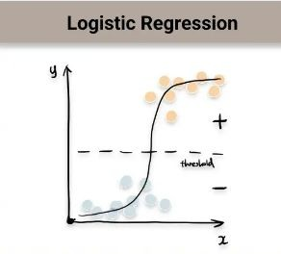
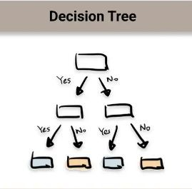
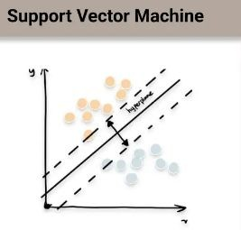
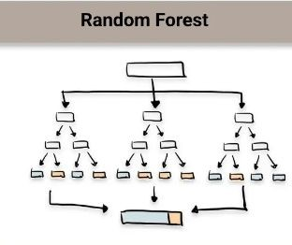
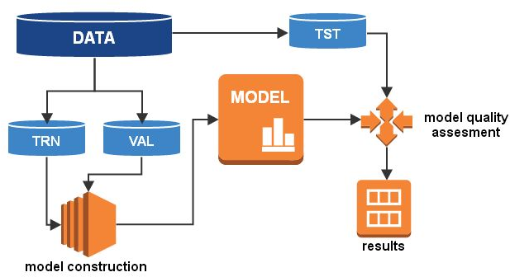
Supervised ML Classification Machine Learning algorithms
1.
2.
3.
4.

Slide 18



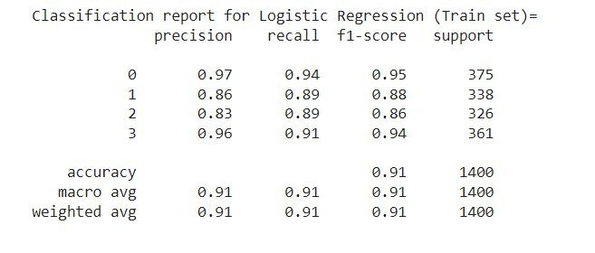
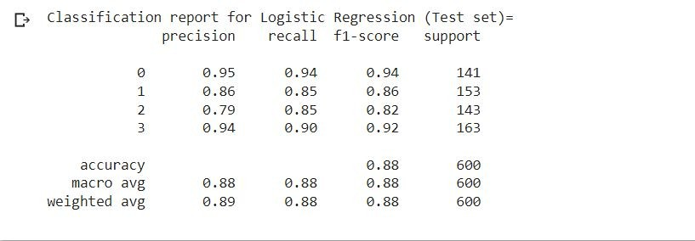
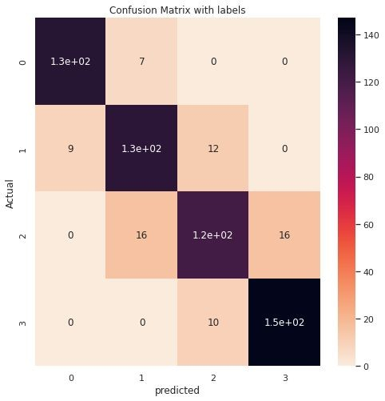
1. Logistic Regression
Logistic regression is a Machine Learning classification algorithm that is used to predict the probability of certain classes based on some dependent variables. In short, the logistic regression model computes a sum of the input features (in most cases, there is a bias term), and calculates the logistic of the result.
TRAIN ACCURACY : 91%
TEST ACCURACY : 88%

Slide 19



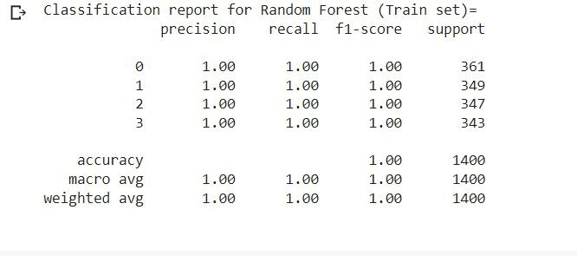
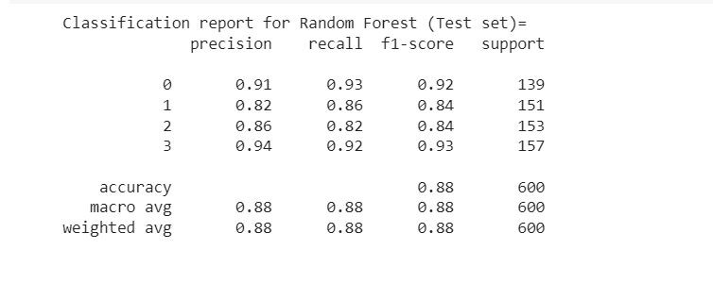
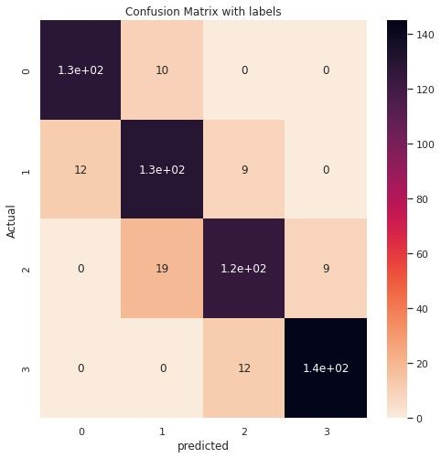
2. Random forest
A Random Forest Algorithm is a supervised machine learning algorithm which is extremely popular and is used for Classification and Regression problems in Machine Learning. We know that a forest comprises numerous trees, and the more trees more it will be robust.
TRAIN ACCURACY : 100%
TEST ACCURACY : 88%

Slide 20
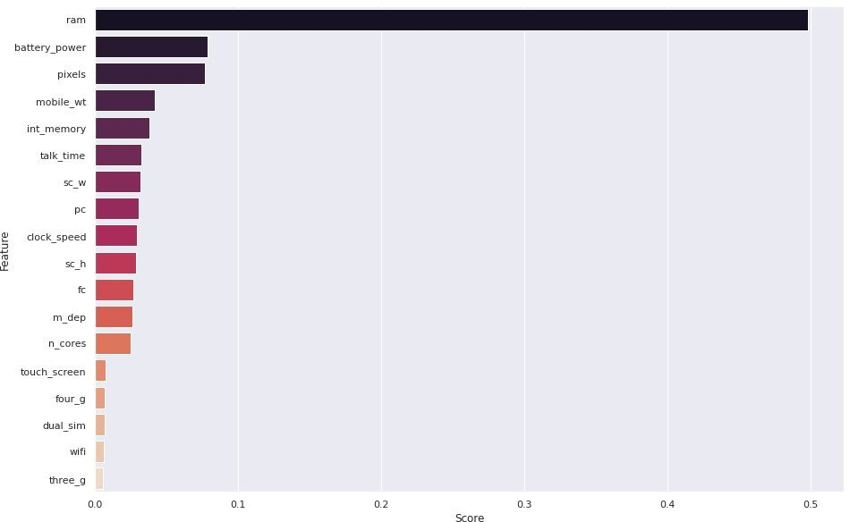
Feature importance Decision tree
Feature importances are provided by the fitted
attribute feature_im portances_ and they are computed as the mean and standard deviation of accumulation of the impurity decrease within each tree.

Slide 21
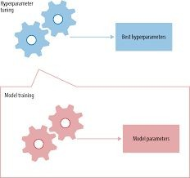

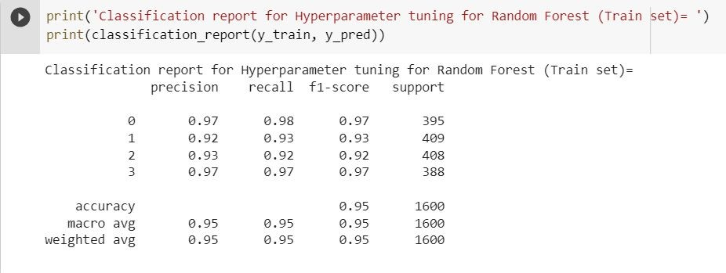
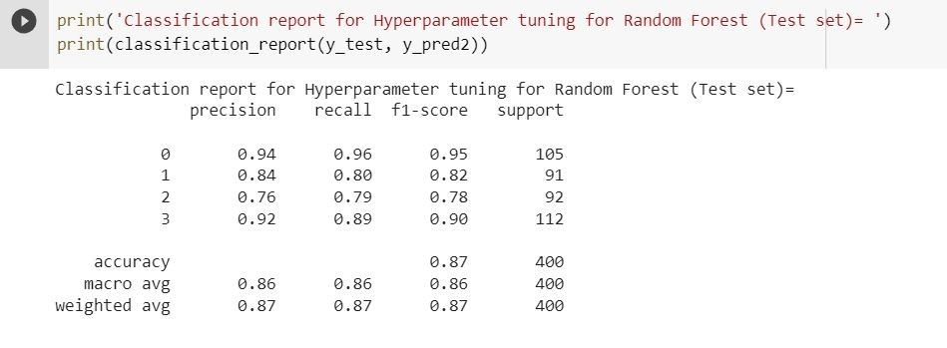
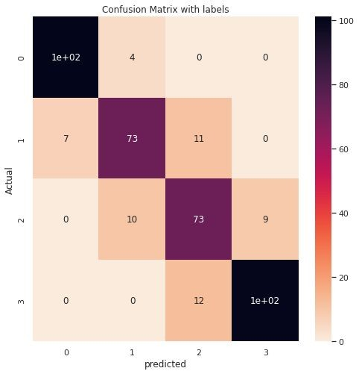
Hyperparameter tuning for Random Forest
In the case of a random forest, hyperparameters include the number of decision trees in the forest and the number of features considered by each tree when splitting a node. (The parameters of a random forest are the variables and thresholds used to split each node learned during training)
TRAIN ACCURACY : 95%
TEST ACCURACY : 87%

Slide 22
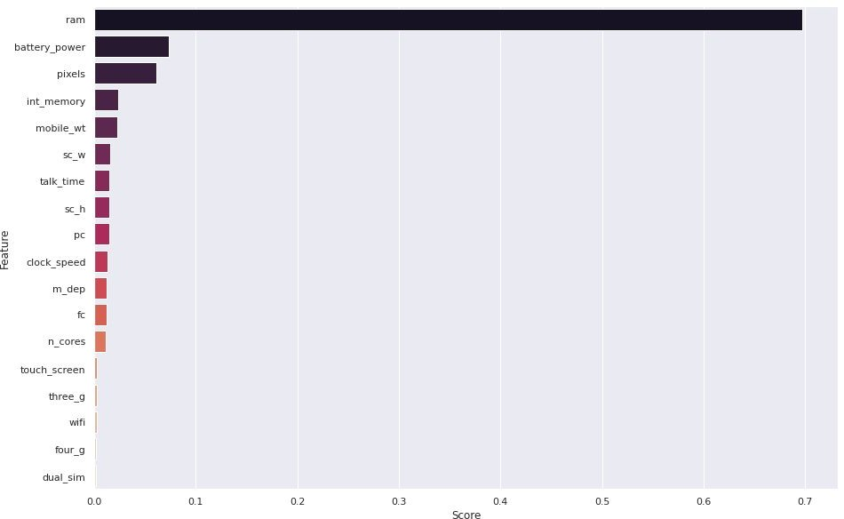
Feature importance for Hyperparameter tuning for Random Forest

Slide 23

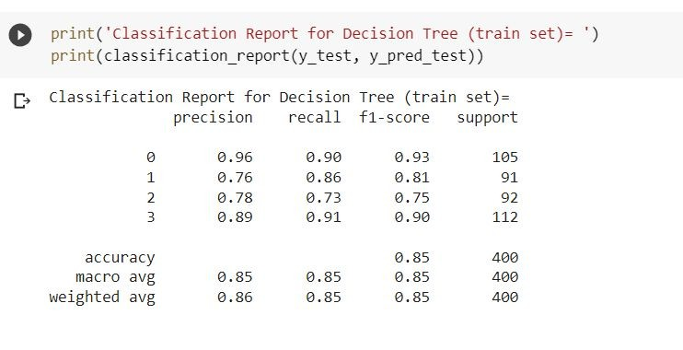
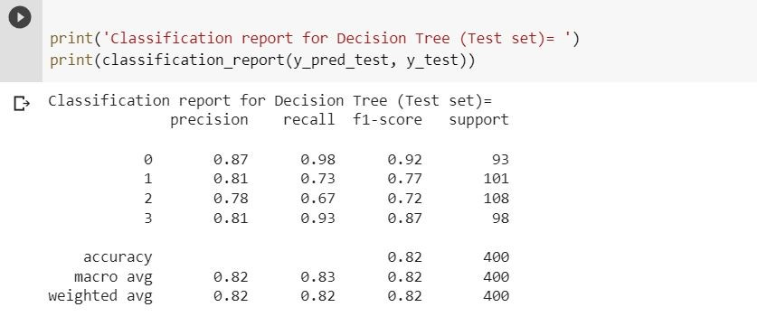
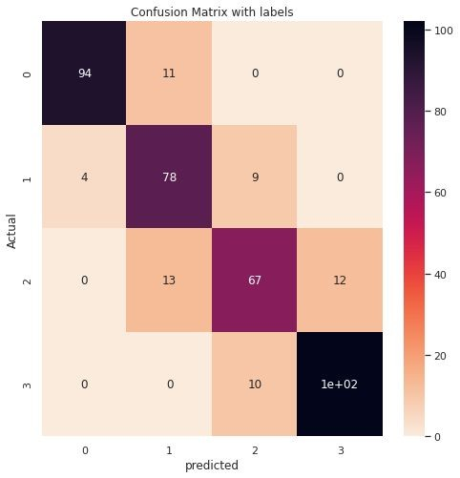
3.Decision tree
A decision tree is a non-parametric supervised learning algorithm, which is utilized for both classification and regression tasks. It has a hierarchical, tree structure, which consists of a root node, branches, internal nodes and leaf nodes.
TRAIN ACCURACY : 85%
TEST ACCURACY : 82%

Slide 24


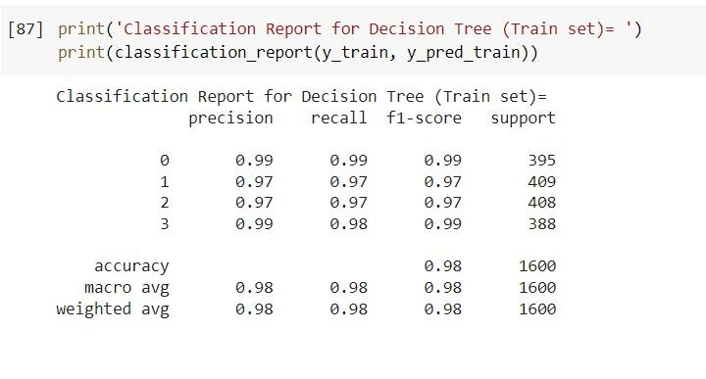
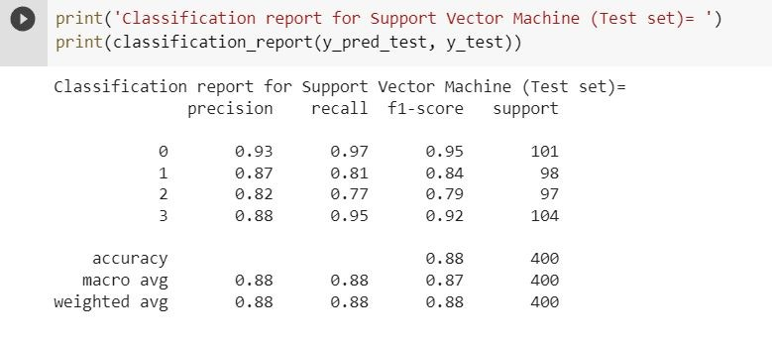
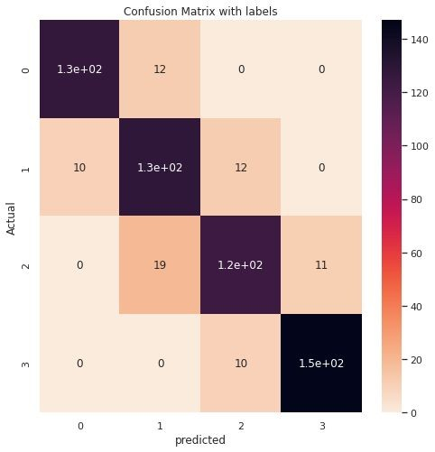
4. SUPPORT VECTOR MACHINE
Support Vector Machine(SVM) is a supervised machine learning algorithm used for both classification and regression. Though we say regression problems as well its best suited for classification. The objective of SVM algorithm is to find a hyperplane in an N-dimensional space that distinctly classifies the data points.
TRAIN ACCURACY : 98%
TEST ACCURACY : 88%

Slide 25

Conclusion
1. From EDA we can see that here are mobile phones in 4 price ranges. The number of elements is almost similar.
half the devices have Bluetooth, and half don’t
There is a gradual increase in battery as the price range increases Ram has continuous increase with price range while moving from Low cost to Very high cost
costly phones are lighter
RAM, battery power, pixels played more signiﬁcant role in deciding the price range of mobile phone.
form all the above experiments we can conclude that logistic regression , SVM and Hyperparameter tuning for Random Forest we got the best results
This project model could be improved by developing software that could predict by selecting features so that it could be used while launching the new product.

Slide 26
Thank You

